Slide 1
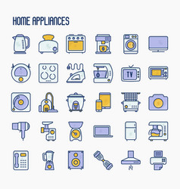
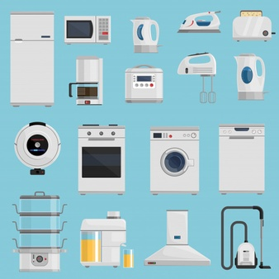
Mobile, Electronics & Appliances
Study To Understand Shifts Due To COVID
Report of Findings | December 2020

Slide 2
MOBILE & ELECTRONICS

Slide 3
Electronics bought since unlock v/s planning to buy
Mobile/Smartphone is most popular in the electronics category. However, Fitness products are picking up as a preferred choice during the festive season till EoY celebrations
Change
-21 %
-43 %
- 13 %
- 6 %
+28 %
+ 33 %
+ 38%
-50 %
Figures in %

Slide 4
Preferred medium of purchasing electronics
Online is the most preferred mode to buy Mobiles & Electronics.`
Offline Electronic shopping 62%
Figures in %

Slide 5
Shopping Budget for electronics this festive season/EoY
3 in 4 consumer’s budget would be less or same as last festive season
Almost 1 out 4 in age group of 25-34 will have higher budget this festive season
Budget this festive season
Driven by
Age group 25-34yrs 26%
Income (INR)
Zone
Figures in %

Slide 6
SMALL APPLIANCES

Slide 7
Small appliances bought since unlock vs planning to buy
Post-unlock, consumers initially were considering sanitizers, however, since the onset of festive season till EoY celebrations, Cleaning & Kitchen appliances are the preferred categories
Consumers focus on hygiene and DIY for home & living
Change
+55 %
+10 %
+3%
-35 %
0 %
Figures in %

Slide 8
Preferred mode to purchase small appliances
Similar to Personal care/ home items, Small appliances see a balance between Online & offline modes
Offline Home Appliances/Small Appliances shopping 69%
Figures in %

Slide 9
LARGE APPLIANCES

Slide 10
Large appliance bought in unlock v/s planning to buy
Entertainment quotient is key for consumers throughout owing to pandemic, but traction has risen for Microwave & Dishwashers since unlock leading to Festival season/EOY
Change
+ 60 %
Driven by
South 11%
North 9%
+22 %
+10 %
+8 %
Driven by
North 14%
East 13%
0 %
+50 %
+27 %
0 %
Figures in %

Slide 11
Preferred purchase medium for Large appliance
Inspite Online gaining popularity during pandemic, for Large Appliances category, consumers are sticking to Offline or retail shopping as preferred mod
Offline large Appliance shopping 70 %
Figures in %

Slide 12
Shopping budget for appliances this festive season
7 out of 10 consumers willing to spend more or same on large appliances than last festive season
8 out 10 consumers will be spending either less or same on small appliances than last festive season
LARGE APPLIANCES
SMALL APPLIANCES
Driven by
Age group 18-34yrs 33%
& 45+ 34%
Driven by
Age group 25-34yrs 27%
Income (INR)
Figures in %

Slide 13
Driver for Non-buyers
Safety measure & Deals are two foremost parameter compelling Non-buyers
Driven by
Male 47%
Driven by
West 52%
North 49%
Figures in %

Slide 14
THANK YOU

